Slide 1
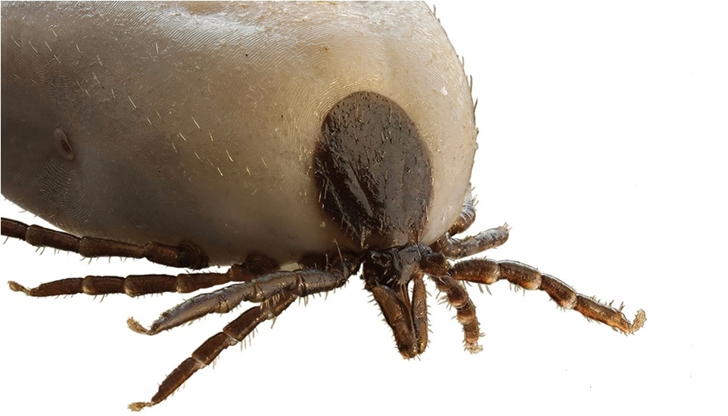
Tick-borne encephalitis (TBE)

Slide 2
Introduction to tick-borne diseases
Diseases spread by bites from infected ticks
2. Can be caused by bacteria, viruses, and parasites
3. Most infections occur in the spring and summer months
4. Geographic distribution of tick species impacts location of human infections

Slide 3
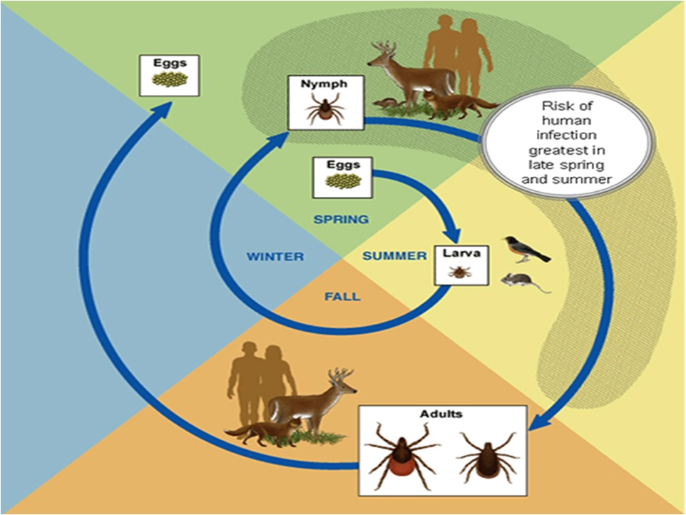
Notes:
This diagram shows an example of a tick life cycle. The eggs hatch in the spring and develop into larvae. The larvae feed on birds and small mammals. If these birds and small mammals have a pathogen in their bloodstream, the tick will ingest this pathogen as they feed on the animal’s blood. Through the fall and winter the larvae develop further and emerges as nymphs in the following spring. As nymphs, the ticks will feed on larger mammals including deer and humans throughout the spring and summer. If the tick was infected with a pathogen at the larval stage while feeding on a bird or small mammal, it will pass this pathogen on to its next host, such as a human, as it feeds in the nymph stage. The nymph develops into an adult which can also feed on larger mammals and eventually lay eggs to start the life cycle over.
The birds and wild mammals that ticks feed on actually serve as reservoirs for the pathogens of tickborne diseases and are a necessary part in the transmission of these diseases. In contrast, humans generally act as incidental or dead-end hosts and do not further propagate the transmission of tickborne diseases.
Hard ticks that transmit tickborne diseases have four life stages: egg, six legged larvae, eight legged nymph, and adults. Most tick species prefer to feed on different hosts at each of these life stages. Ticks can feed on a variety of animals including mammals, birds, reptiles, and amphibians.

Slide 4
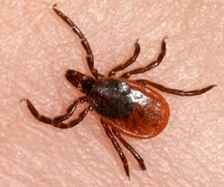
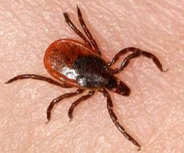
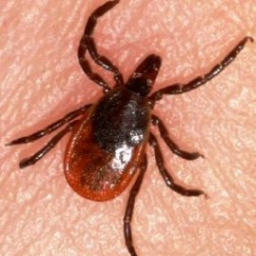
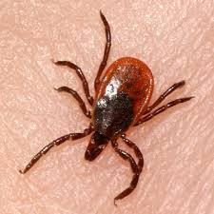
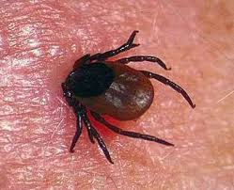
Introduction to tick-borne diseases
Tick-borne encephalitis
2. Lyme disease
3. Vesicle rickettsiosis
4. Other types of rickettsiosis
(~80 types)

Slide 5
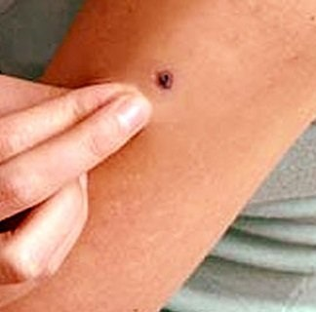
Non-specific prevention of TBI
avoidance of tick-infested areas
use of repellents
avoidance of unboiling milk
use protective clothing
self-examination
group-examination

Slide 6
Tick-borne encephalitis
TBE is a disease caused by tick-borne encephalitis virus (TBEV) that is transmitted mainly by Ixodes spp. ticks and may manifest as a fever, aseptic meningitis, meningoencephalitis and rare others CNS abnormalities.

Slide 7
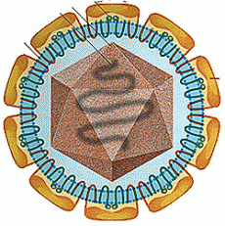
Tick-borne encephalitis
The virions of TBEV are spherical particles, 50–60 nm in diameter with a nucleocapsid composed of a (+)ssRNA genome enclosed in a C (core) protein and surrounded by M- and E-glycoproteins a host cell-derived lipid bilayer.
Durable at low temperatures.
The dried state can persists for many years.

Slide 8
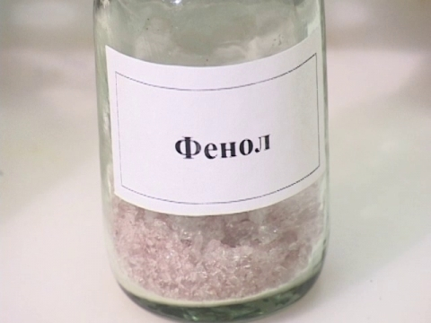
Tick-borne encephalitis
It is inactivated by boiling, after 2 min., in hot milk (+60 degrees) - in 20 min.
Inactivating effects are: formalin, phenol, ultraviolet radiation.

Slide 9
Tick-borne encephalitis
the Central European TBEV
Siberian TBEV
Russian spring-summer TBEV
Notes:
3 EURO, 5 in Russia

Slide 10
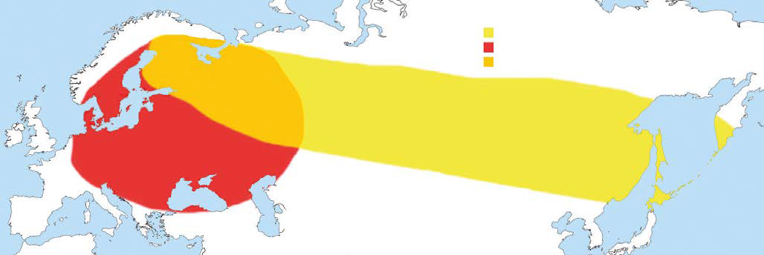
Tick-borne encephalitis

Slide 11
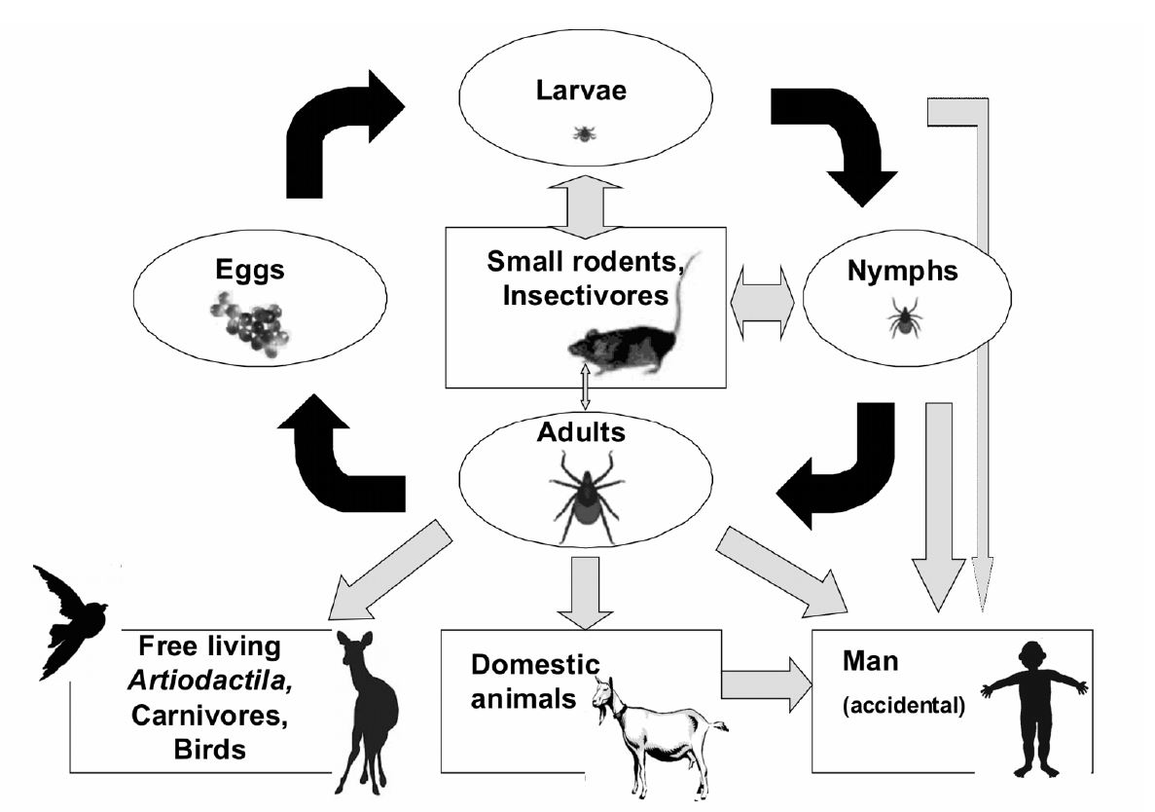

Slide 12
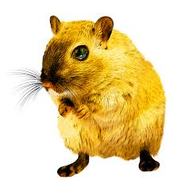
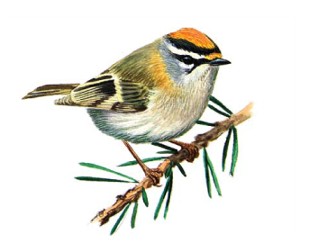
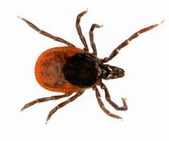
Tick-borne encephalitis
The main vector of European TBEV is Ixodes ricinus, of the Siberian and Far Eastern TBEV – Ixodes persulcatus.
The main reservoir of TBEV in nature are the same types ticks. The additional reservoir for TBEV are small mammals, birds, wild animals.

Slide 13
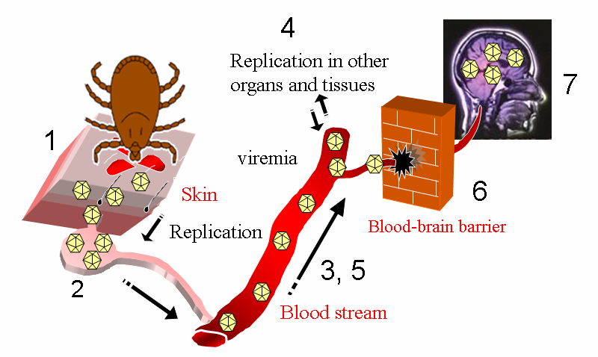
Tick-borne encephalitis
Notes:
After the tick bite, the virus replicates in subcutaneous tissues. Dendritic cells in the
skin are likely to serve as a vehicle for the transport of the virus to draining lymph nodes.
The lymph nodes play an important part in the pathogenesis of TBE.
However, virus replication is not accompanied by any virus-specific histological changes
including any destruction of cells in the nodes. Massive viral multiplication in the nodes leads to the spreading of virus into the blood
stream and induction of viremia. Temporary leukopenia in the white
blood picture is observed. A significant decrease is recorded in all cellular elements. In
regional lymph nodes, a significant decrease in lymphocytes appears.
Many extraneural tissues are infected during the viremic phase and, subsequently during
the secondary viremia, the virus invades the CNS by still unknown mechanism.

Slide 14
Tick-borne encephalitis
Clinical classification
fever form
aseptic meningitis
meningoencephalitis
poliomyelitis-like paralysis
myeloradiculitic form

Slide 15
Tick-borne encephalitis
The incubation time is between two and 28 days, with an average of seven days.
The viraemic phase, which lasts between 2-8 days, is characterised by flu-like symptoms with a slight temperature increase, headache, tiredness, aching back and limbs and nausea.
Thereafter, there follows a period without clinical symptoms and, in one-third of patients, a second phase of disease occurs, characterised by a sudden onset of fever.

Slide 16
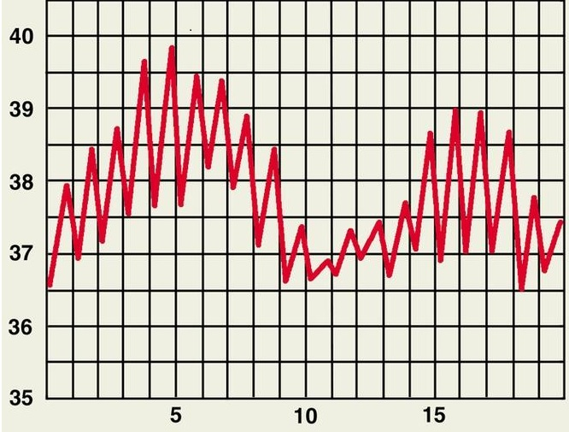
Tick-borne encephalitis

Slide 17
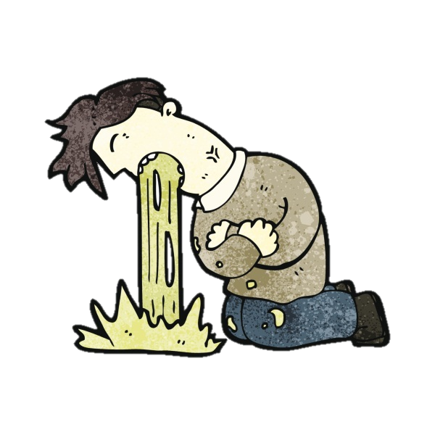
Tick-borne encephalitis
Vomiting and nausea
Fever
Asthenia
Headache

Slide 18
Tick-borne encephalitis
During this stage the virus spreads to the CNS and causes anorexia, fever, headache, vomiting, photophobia and sometimes sensory changes, visual disturbances, paresis, paralysis, or even coma.
Other symptoms include hyperkinesis of the limbs and face muscles, lingual tremor, convulsions, and paresis of the respiratory muscles.

Slide 19
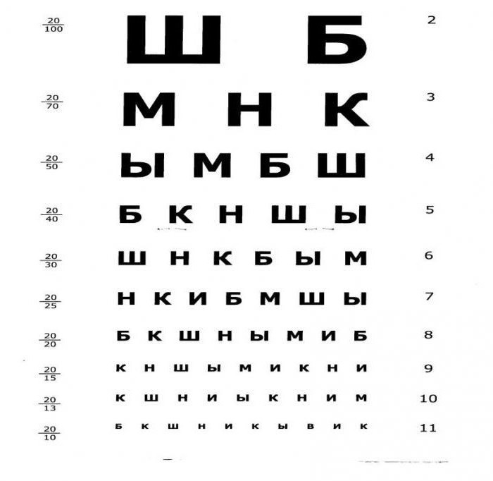
Tick-borne encephalitis
Oculist
Neurologist

Slide 20
Tick-borne encephalitis
Serology | PCR
Allows reliable detection of IgM and IgG antibodies in serum and CSF up from the 2nd week of disease | Allows early diagnosis by detection of TBE virus specific RNA in the first phase of infection, if patient is hospitalized at this time point
Cross-reactions with antibodies elicited by other flaviviruses | Provides opportunity to discriminate between TBE virus subtypes
Commercial kits are available | Requires trained laboratory personnel

Slide 21
Tick-borne encephalitis
Hospitalization for
- All cases «TBEV?»
- All people with RNA TBEV «+»

Slide 22
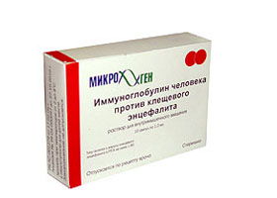
Anti-tick’s Ig
1,0 per 10 kg once a day
1,0 per 10 kg twice a day
1,0 per 10 kg 2-3 a day
1,5 per 10 kg 2-3 times a day

Slide 23
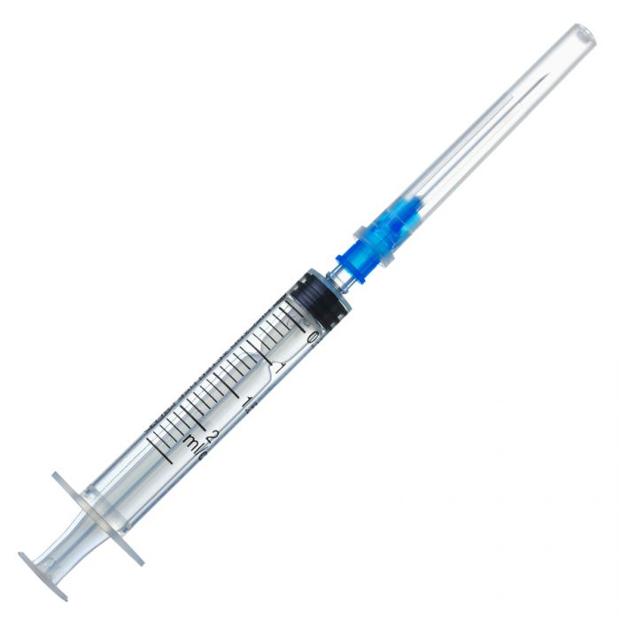
Specific prevention of TBI
TBE can be successfully prevented by active immunization.
EnceVir
Encepur
Клещ-Э-вак
Вакцина клещевого энцефалита
Due to the highly conserved structure of this antigen broad cross-protection by the vaccines could be shown against TBE viruses of all three subtypes
The conventional immunization schedules for primary immunization are similar for both vaccines, with three intramuscular doses given on 0, 21 days–3 months and 9–12 months.

Slide 24
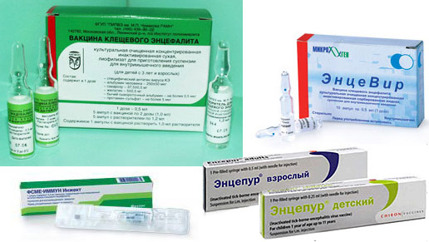
Specific prevention of TBI
The conventional immunization schedules for primary immunization are similar for both vaccines, with three intramuscular doses given on 0, 21 days–3 months and 9–12 months.

